Slide 1
2021-22
Wrestling Rules
Rule 4
Wrestlers’ Classification and Weigh ins

Slide 2
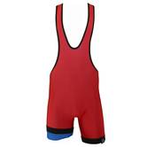
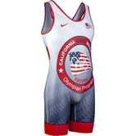
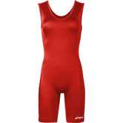
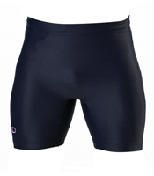
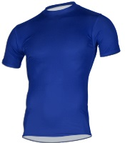
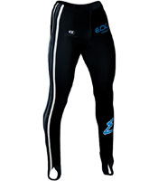
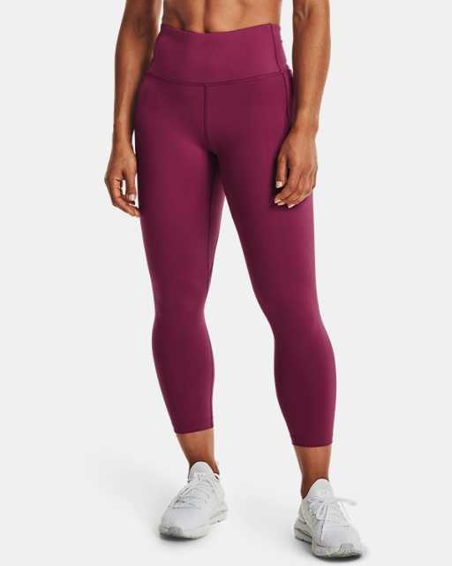
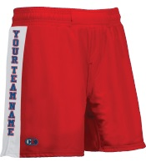
UNIFORMS
A
B
C
D
G
H
I
E
F

Slide 3
Uniforms
Legal for both boys and girls
Illegal-must be ½ up from the waist
Illegal-must be a school issued uniform
Legal Women’s cut-both genders can wear this
Legal-competition short-must be school issued
Legal competition short-must be school issued
Legal competition shirt-must be school issued
Legal if they have stirrups
Illegal-no stirrups

Slide 4
UNIFORMS
If a wrestler reports to the mat with uniform straps taped or crisscrossed to fit better, what should happen?
Does the coach get penalized as well for improperly equipped wrestler?
If shoe is legal when you start a match and then the shoelaces come undone-what occurs? Do you start the injury clock?
If the shoe comes off, during wrestling-what is the penalty?

Slide 5
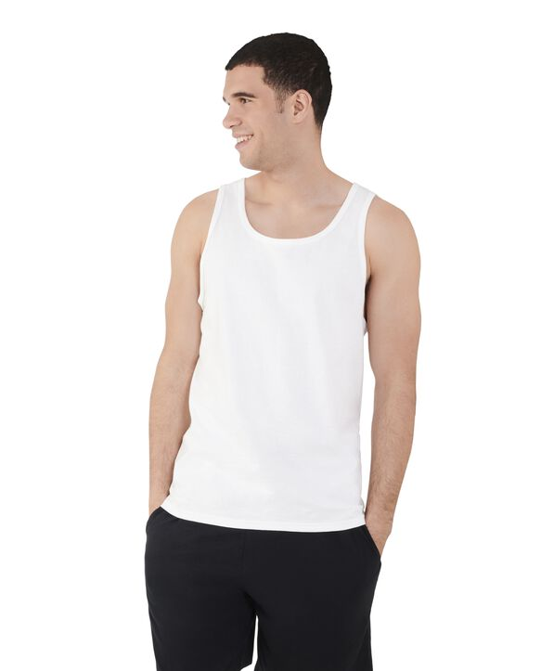
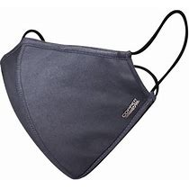
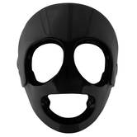
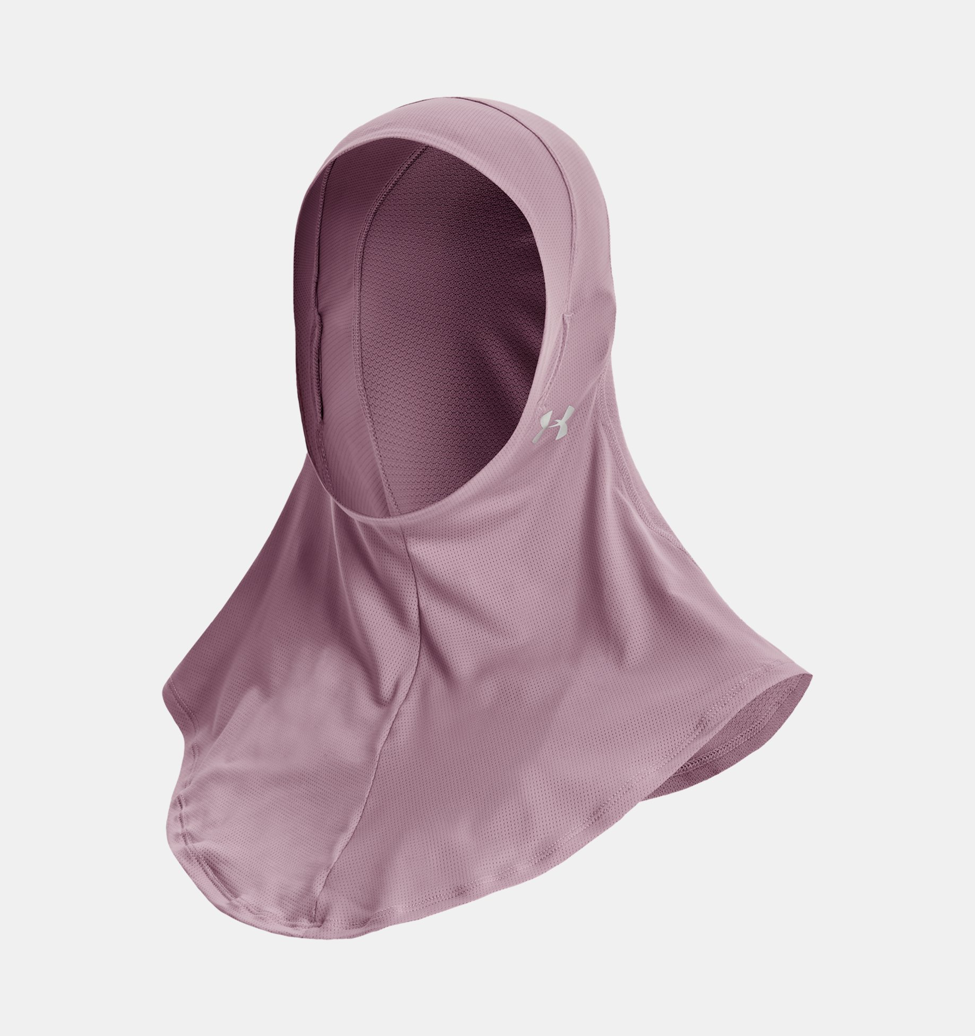
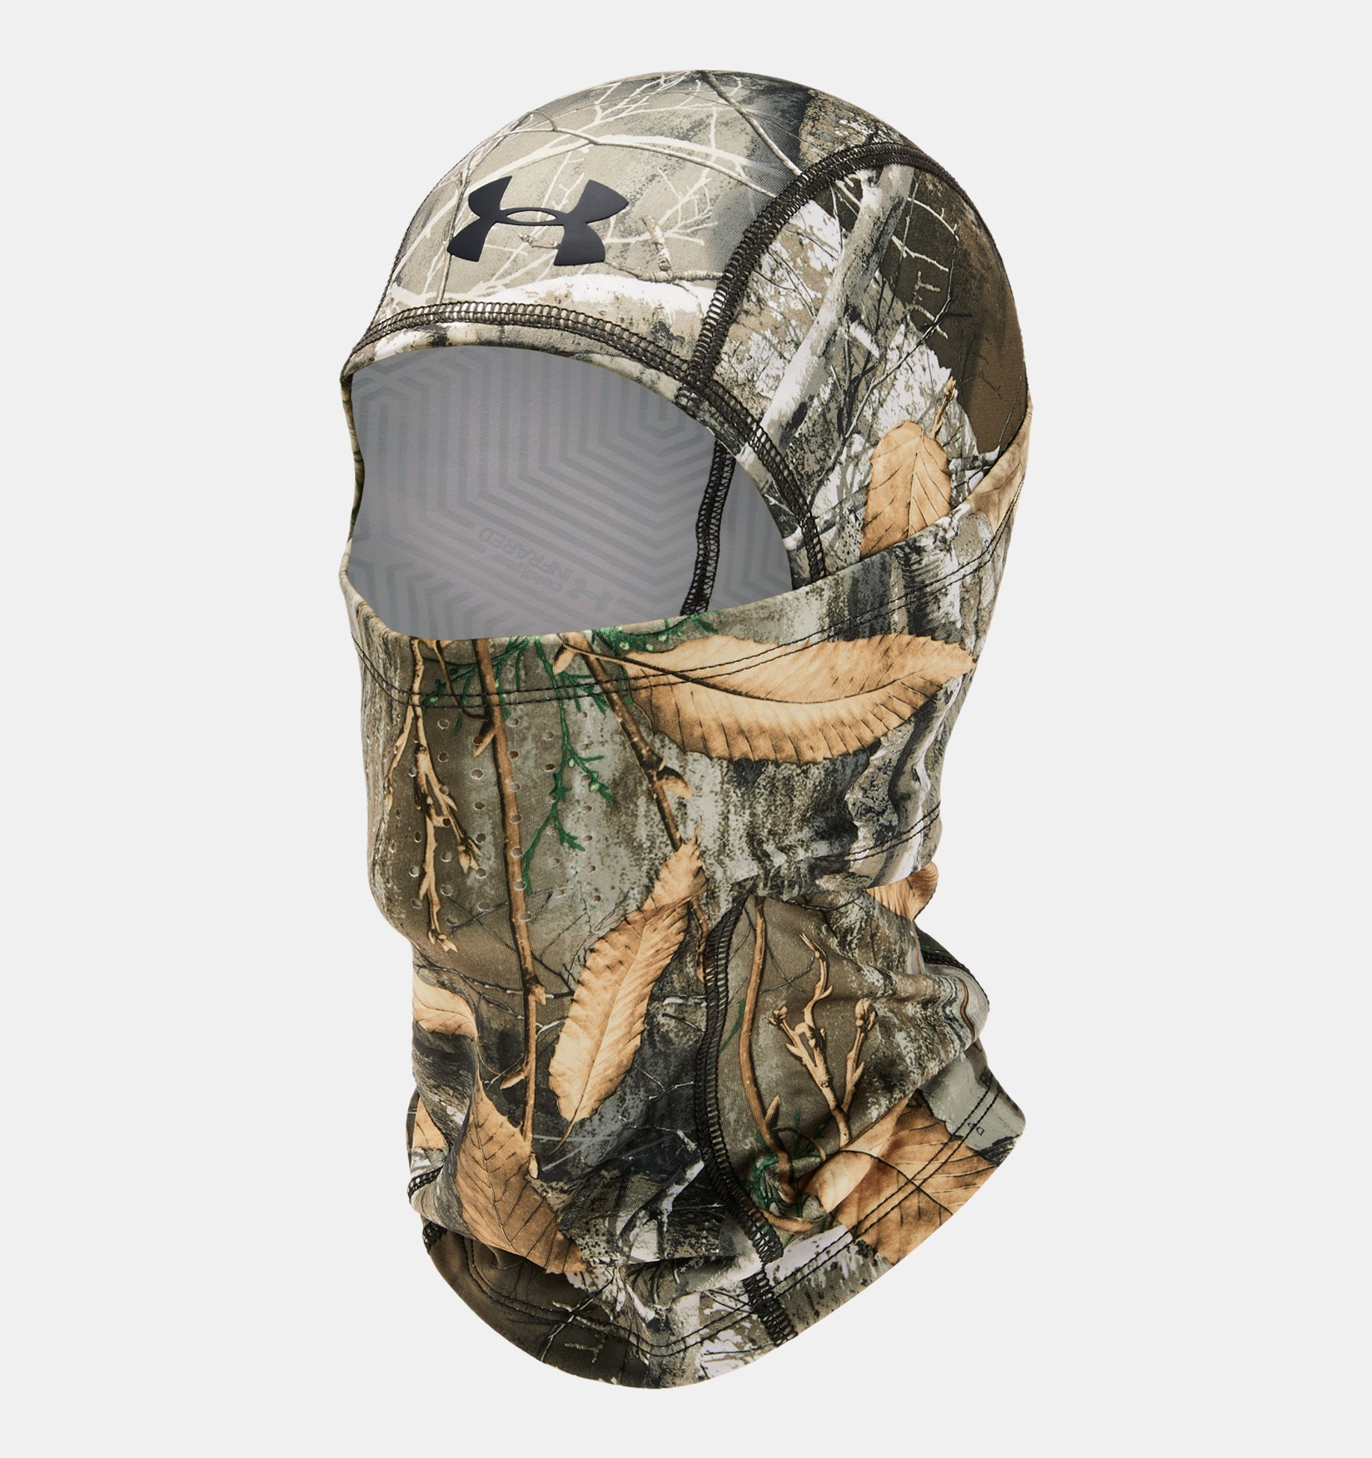
UNIFORMS/EQUIPMENT
Can a wrestler wear the tight fitting competition shirt under a school issued singlet?
Can a wrestler wear a sleeveless shirt under the singlet?
Which facemask is legal?

Slide 6
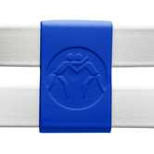
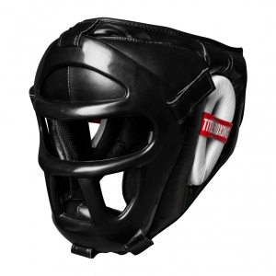
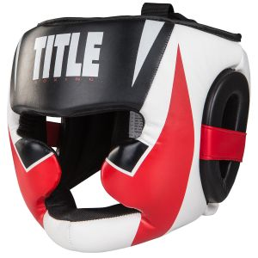
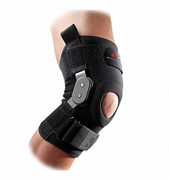
EQUIPMENT
Can these be used on the headgear?
Can the straps on the headgear be crossed?
Can the straps on the headgear be taped together?
Are stickers allowed on the headgear?
Can these headgear be used?
6. Can this knee brace be used?

Slide 7
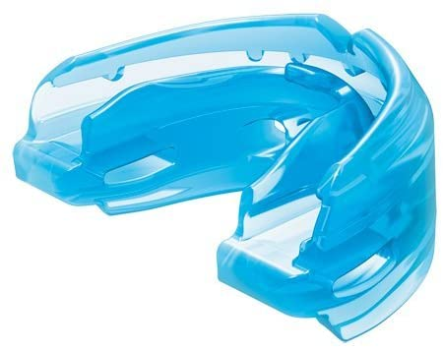
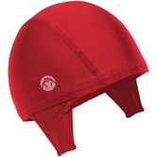
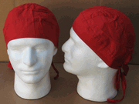
EQUIPMENT
7. Braces need to covered by similar mouthguard
8. Can these haircaps be used?

Slide 8
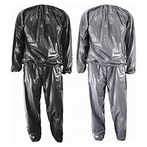
WEIGHN-INS
At a tournament if a wrestler misses weight on a scale-what are the wrestler options?
If you receive a CIF skin form signed by a doctor that states the wrestler can compete, you investigate and the skin conditions still does not look non-communicable, what can you do?
Can anyone override your decision and/or the signed form?
As you drive into the site and see a wrestler running in one of these:
What do you do?

