Slide 1
Rule 8
Penalties and Injuries

Slide 2
Ready to Wrestle
Any contestant reporting to the scorer’s table not properly equipped or not ready to wrestle is a technical violation. A wrestler with greasy substance on the body or uniform, improper grooming, objectionable pads and braces, illegal equipment, illegal uniform or any equipment that is detected as being illegal after the match has started shall be disqualified if not removed or corrected within the 1 1⁄2 minute injury time.
Examples:
Shoelaces not secured with tape, Velcro, “double knotted” or “in a pocket”; being “tucked in” is not allowed
and a Technical Violation
Improper under garments: e.g. boxer shorts, loose tee shirts, “floppy socks” or arm/leg sleeves
Taped headgear / uniform or not worn properly
”Special Equipment” e.g. braces, pads, hair coverings (connected to headgear), face masks;
objectionable logos or writing on special equipment
Grooming issues, e.g. beard, stubble on chin or head;
Mouth guards: (to cover braces)
Fingernails not trimmed (should be caught at “groom check”)

Slide 3
Ways to Address and Avoid Issues at Table
Dual Meets:
Be sure to meet with team prior to match e.g. weigh-ins (if present) or the groom check
go over the things that might be an issue, like reminding everyone to have their shoe laces secured
Ask about support braces or being taped up, hair coverings, remind them about mouth guards
ALWAYS ASK Head Coach to verify that all wrestlers are groomed, properly equipped and “ready to wrestle”, including shoelaces
Remind them at the pre-match meeting with Head Coach and Captains
Tournaments: start at ”weigh-ins” and verify at groom check
At the table verifying previous match, look at kids as they are waiting for their match
Before they step on mat, try to check their shoelaces, obvious issues, give them a clue
Always better to get it resolved before having to award a penalty point

Slide 4
Taunting an opponent
We have all had or will have a “heated” match where the kids are ”jawing” at each other, either in a pinning situation or when they are on the mat
Sometimes they know each other, and they are just being kids;
If not within earshot of coaches / bench / table, it is best to tell them to “knock it off” and “wrestle”;
If they don’t obey or continue and / or are too obvious, stop the match and penalize one or both for Unsportsmanlike behavior

Slide 5
Stopping the Match for Warnings and Penalties
Always stop the match for:
Safety issue to protect wrestlers
Illegal moves
1 match pt.
Unsportsmanlike (multiple occurrences can be viewed as Flagrant Misconduct)
1 match pt. (time from reporting to table to end of 3rd period; otherwise 1 team pt.
Unnecessary Roughness (multiple occurrences can be viewed as Flagrant Misconduct)
1 match pt.
4th Stalling Warning
2 match pts., and choice of position to opponent
Flagrant Misconduct
Match is over (deduct 3 team pts and remove from premises)
Warning or Awarding Penalty Points (see exceptions)
Warning and Penalizing Offensive Wrestler on mat (see exceptions)

Slide 6
Exceptions to Stopping the Match for Warnings and Penalties
Do not stop the match when warning or penalizing for the following situations
Defensive wrestler for stalling (except for 4th stall warning)
Either wrestler for stalling in neutral position (except for 4th stall warning)
Offensive wrestler for stalling when defensive wrestler is on his feet (except for 4th stall warning)
Penalizing defensive wrestler in a pinning situation except for safety of offensive wrestler
When the above situation has ended, stop the match and award appropriate points
Technical violation e.g. fleeing the mat during an imminent scoring situation, locking hands or grasping clothing while defensive wrestler is attempting escape or reversal
Grasping clothing when opponent is attempting a takedown
If the wrestler is successful in the above attempts / situations, do not stop match but award points, if not successful, stop match and award appropriate penalties

Slide 7
Penalty Charts
The penalty chart has been separated into one for Stalling and one for the other Penalties:
Illegal Holds
Unnecessary Roughness
Unsportsmanlike Conduct
Flagrant Misconduct
Technical Violations
After the “fourth” penalty, stop the match and opposing wrestler gets choice of position

Slide 8
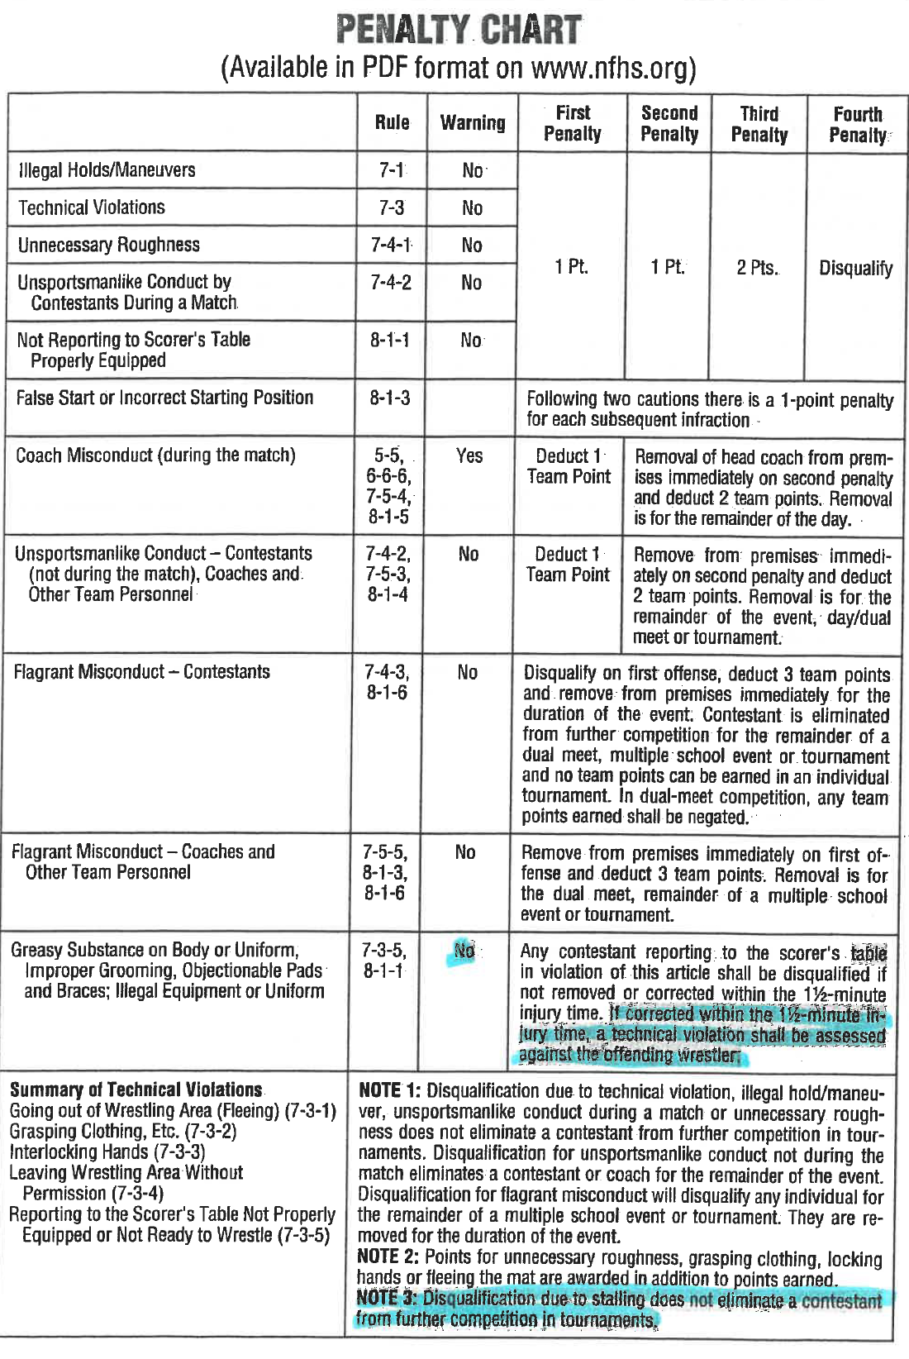

Slide 9
Injury time and recovery time
Each wrestler is allowed 1 ½ minutes of injury time (cumulative) with maximum of 2 time-outs per match including overtime
After 2nd time-out, the opponent gets choice of position (see all various situations next slide)
Know 8.2.1 Situation F (choices) in case book, understand scenarios and it will make sense
Time to correct illegal equipment is charged as an injury time-out; (be sure to record in scorebook)
e.g. securing shoe laces etc. (as well as a 1 pt. technical violation); contact lenses ??
Wrestler is allowed up to 2 minutes of Recovery Time for each illegal hold committed against him / her; injury time cannot be added to recovery time
If the wrestler is unable to continue at the end of 2 minutes, he / she wins by default
Wrestler cannot default match after 2 minutes have expired
Work with coaches to explain options if they ask

Slide 10
Choices after 2nd charged Injury time-out
a. If the second injury time-out is taken at the conclusion of the first period, the opponent shall have the choice at the start of the second and third periods.
b. If the second injury time-out is taken at the conclusion of the second period, the opponent shall have the choice at the start of the third period.
c. If the second injury time-out is taken at the conclusion of the second period, and the opponent already has the choice at the beginning of the third period, the opponent would then have the added choice at the first restart after the beginning of the third period.
d. If the second injury time-out is taken at the conclusion of the third period, the opponent shall have the choice of any one of the three starting positions at the beginning of the sudden victory period.
e. If the second injury time-out is taken any time during the sudden victory period, the opponent shall have the choice of top, bottom or neutral position on the restart.
f. If the second injury time-out is taken at the conclusion of the sudden victory period, the opponent shall have the choice of either top or bottom position at the start of both 30-second tiebreaker periods.
g. If the second injury time-out is taken at the conclusion of the first 30-second tiebreaker period, the opponent shall have the choice of either top or bottom position at the start of the second 30-second tiebreaker period.
h. If the second injury time-out is taken at the conclusion of the first 30-second tiebreaker period and the opponent already has the choice at the beginning of the second 30-second tiebreaker period, the opponent would then have the added choice at the first restart after the beginning of the second 30-second tiebreaker period.
i. If the second injury time-out occurs at the conclusion of the second 30-second tiebreaker period unless an opponent has received an unsportsmanlike conduct penalty at anytime during the match, the opponent shall have the choice of top or bottom position at the start of the ultimate tiebreaker period.
j. If the second injury time-out occurs during either of the 30-second tiebreaker periods or during the ultimate tiebreaker period, the opponent shall have the choice of top or bottom position on the restart.

Slide 11
Points to Remember
Blood Time 5 min. supersedes Injury Time and HNC (complete blood time first)
if bleeding occurs as a result of unsportsmanlike conduct, illegal holds or unnecessary roughness and the bleeding contestant uses 5 minutes of blood time, the injured wrestler will be the winner of the contest by default.
False start from neutral position resulting in injury to opponent, 1 pt. and recovery time
Requirements for long hair;
if a wrestler chooses to contain his/her long hair by some hair-control device (must be tight) such as a rubber band or non-abrasive hair cover that is attached to head-gear. e.g. hair groomed into cornrows, dreadlocks, permed, etc. is legal as long as it isn’t hard or abrasive and it meets the length and containment requirement. For example, hair in ponytail or dreadlocks controlled by rubber band past shirt collar or longer is legal.

Slide 12
Points to Remember
A Concussion Evaluation Time Extension
We have modified the injury time-out to incorporate more time to evaluate any head, neck, cervical column and/or nervous system. When an appropriate health-care professional is present, he or she has the authorization to extend the time to evaluate the wrester’s condition to a maximum time limit of five (5) minutes. If a subsequent similar injury occurs during the same match, then the injured wrestler shall default the match. When this provision is used, the time consumed for evaluation of the injury shall not affect time used or available for other types of injuries.
Blood time would supersede evaluation time
The 5-minute evaluation starts when health-care professional arrives to look at athlete

Slide 13
Head, Neck, Cervical/Nervous System Injuries
The following modifications to injury time-outs will be used in all competition regarding injuries to the head and neck involving cervical column and/or nervous system.
In the absence of appropriate health-care professional, (physician and/or certified athletic trainer) all injuries to the head and neck involving the cervical column and/or nervous system (HNC) will be covered by Rule 8-2-4a. (5-28-3, 5-28-6, 6-4-3, 8-2-6, and 8-2-9)
When appropriate health-care professional(s) are present, they have jurisdiction to extend the allowed time to a maximum of five (5) minutes for evaluation of the injuries to the head and neck involving cervical column and/or nervous systems only during the allowed time limit (maximum) of five (5) minutes. After that evaluation, the wrestler would be required to prepare without delay for continuation or default the match.
A second occurrence of injury to the head and neck involving cervical column and/or central nervous system in the same match shall require the wrestler to default the match.
NOTE: When this provision is used, the time consumed for the injury will in no way affect time used, or available, for other types of injuries.

Slide 14
Head, Neck, Cervical/Nervous System Injuries
New Article:
ART. 9 . . . When a match is stopped for an injury, including HNC, during an imminent scoring situation and the referee determines that scoring (takedown, reversal, escape, and near-fall) would have been successful if the wrestling had continued, the referee shall charge an injury time-out, or if appropriate an HNC time-out, to the injured contestant and award applicable points to the non-injured wrestler.

Slide 15
Situations
Wrestler A applies a full-nelson and, at the same time, Wrestler B twists an ankle. B's action is unrelated to the illegal hold / maneuver. What is the correct course of action for the referee to take and would this be considered injury time or recovery time?
RULING: The rule states that, if a wrestler is injured as a result of an illegal hold / maneuver, recovery time will be used. In the above situation the injury is not the result of an illegal hold / maneuver, therefore, B would have to use available injury time. Wrestler B would be awarded one point for the illegal hold / maneuver. If he is unable to continue after 1 ½ minutes, wrestler A wins

Slide 16
Situations
The referee stops the match due to an apparent neck injury to Wrestler B. The injury does not involve a concussion. The designated, on-site appropriate health-care professional determines B should not continue to compete. The wrestler, as well as the coach, indicates to the referee that the wrestler can continue. What is the correct ruling?
RULING: The designated, on-site appropriate health-care professional provided by the host shall be the final authority. If Team B has a physician available, the two medical professionals should consult to make the right decision. If there is no compelling reason to change the original decision, the host management's designated, on-site appropriate health-care professional will prevail.

Slide 17
Situations
During a tournament, a non-participating wrestler is acting as a coach in the corner for a teammate. The "wrestler-coach" is removed from the premises due to unsportsmanlike conduct. Does the wrestler forfeit the right to continue participation as a wrestler in the tournament?
RULING: When a wrestler serves as a coach during tournament competition and is removed for unsportsmanlike conduct, the individual cannot wrestle for the remainder of the event. If the individual is removed for flagrant misconduct, the individual can no longer participate in the tournament. (7-5-3)

