Slide 1
NFHS Wrestling Rule 7 – Infractions
By: Bob Edmonds

Slide 2
Slam
SECTION 1
ILLEGAL HOLDS/MANEUVERS
ART. 1 . . . A slam is lifting and returning an opponent to the mat with unnecessary force. This infraction may be committed by a contestant in either the top or bottom position on the mat, as well as during a takedown. A slam shall be called without hesitation. Illegal Holds / Maneuvers 7.1.1 SITUATION A:
Wrestler A lifts the opponent off the mat and, while Wrestler B is in the air struggling to get free, Wrestler A loses control and Wrestler B falls to the mat. Would this be considered a slam? RULING: When you lift your opponent off the mat you are responsible for a safe return to the mat. If you lose control and Wrestler B falls to the mat with unnecessary force, a slam shall be called without hesitation.

Slide 3
Reminder
There is no language in the rule book referencing whose knee hit first.
If warranted, a slam should be called without hesitation and without consideration of intent.
Example – bottom man, standing granby during mat return.

Slide 4
Other illegal holds/maneuvers include, but are not limited to:
a double underhook snap back from the standing position;
b. the hammerlock above the right angle;
c. the twisting hammerlock along with lifting the elbow off the back in a hammerlock situation;
d. any headlock in which the arms or hands are locked around the opponent's head without encircling an arm (elbow or above) or leg (except in the guillotine after near-fall criteria has been met or ¾ Nelson);
e. straight head scissors (even though an arm is included);
f. full nelson;
g. holds/maneuvers putting pressure on the throat and/or carotid artery;
h. twisting kneelock taken against the joint and/or away from the body;
i. keylock;
j. overhead double arm bar;
k. locking the hands behind the back in a double arm bar from the front;
l. neck wrench;

Slide 5
Other illegal holds/maneuvers (continued)
m. front, quarter nelson with the chin;
n. leg block(cut-back);
o. overscissors when pressure is applied against the joint which may cause hyperextension;
p. bending, twisting or forcing the head or any limb beyond its normal limits of movement;
q. back bow;
r. figure 4 around the body, the head or both legs;
s. chicken wing with pressure toward the shoulder, parallel to the long axis of the body;
t. hand(s) in the eye(s) or raking the eye(s);
u. any hold/maneuver used for punishment;
v. any hold/maneuver with pressure exerted over the opponent's mouth, nose, throat or neck that restricts breathing or circulation;
w. a back flip from the standing position; or a front flip and / or front hurdle over an opponent in the standing position, and
x. rear-standing, double-knee kickback.

Slide 6
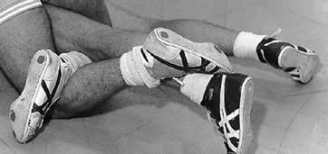
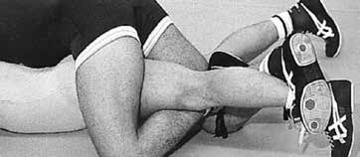
illegal maneuvers
EXAMPLES OF ILLEGAL OVER SCISSORS LOCKS. Leg rides applied by the offensive wrestler that hyperextend the knee beyond its normal limits of movement are illegal.

Slide 7
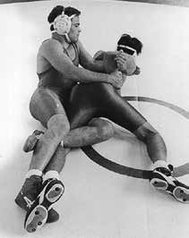
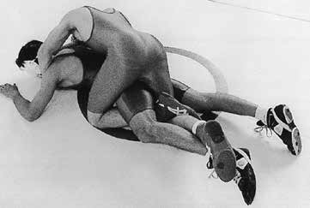
Not illegal
EXAMPLES OF LEGAL LEG LOCKS. Leg rides applied by the offensive wrestler that do not hyperextend the knee are legal.

Slide 8
Rule 7-1-2 illegal maneuvers
A full, straight-back suplay is illegal

Slide 9
Rule 7-1-2 illegal maneuvers
The straight-back salto is illegal.

Slide 10
Rule 7-1-2 illegal maneuvers
ART. 2. . . A full, straight-back suplay and the straight-back salto to the head are illegal.
Rationale: The straight-back salto in the rear standing position that brings the defensive wrestler straight back with feet in the air is intended to have the defensive wrestler's head, neck, or shoulder(s) hit the mat first and should be illegal. This is a dangerous move, regardless of which body part (head, neck, or shoulder(s)) hits the mat first.

Slide 11
illegal maneuvers
A front flip and/or front hurdle over an opponent in the standing position is illegal.

Slide 12
Rule 7-1-5w illegal maneuvers
ART. 5 . . . Other illegal holds/maneuvers include, but are not limited to:
(Photos 28-90)
a.-v. Same text, no changes.
w. a back flip from the standing position; and or a front flip and/or front hurdle over an opponent in the standing position; and

Slide 13
Rule 7-1-5w illegal maneuvers
Rationale:
The attempt of a wrestler to front flip or hurdle his opponent from the neutral position is becoming more apparent. Generally, this maneuver is attempted when there is short time left in a match and a wrestler needs to secure a takedown of his opponent, who has a strong defensive neutral position, in order to either tie or take a lead in a match.

Slide 14
Rule 7-1-5w illegal maneuvers
Rationale: (Continued)
This maneuver is a last ditch effort attempt to score; however, the attempt to flip or hurdle your opponent from a neutral position is not only an elevated risk to the wrestler attempting the maneuver, it also places the opponent in a disadvantage position as they are not only left to counter the scoring attempt but they are also placed in a position of responsibility for not reacting in a manner that may cause a slam or unsafe return to the mat of the wrestler who actually initiated the maneuver.

Slide 15
Technical Violations
5 types – see penalty chart
Fleeing the mat
Grasping clothing (locked hands signal)
Interlocking hands
Leaving wrestling area without permission
Reporting to scorer’s table not properly equipped or not ready to wrestle

Slide 16
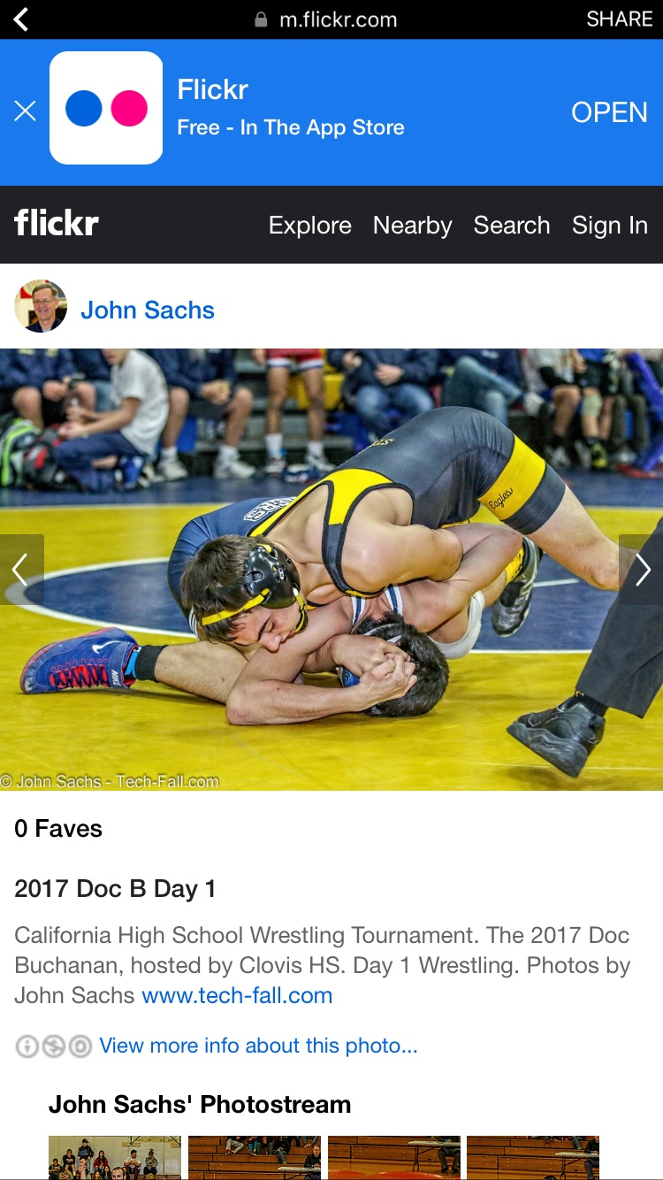
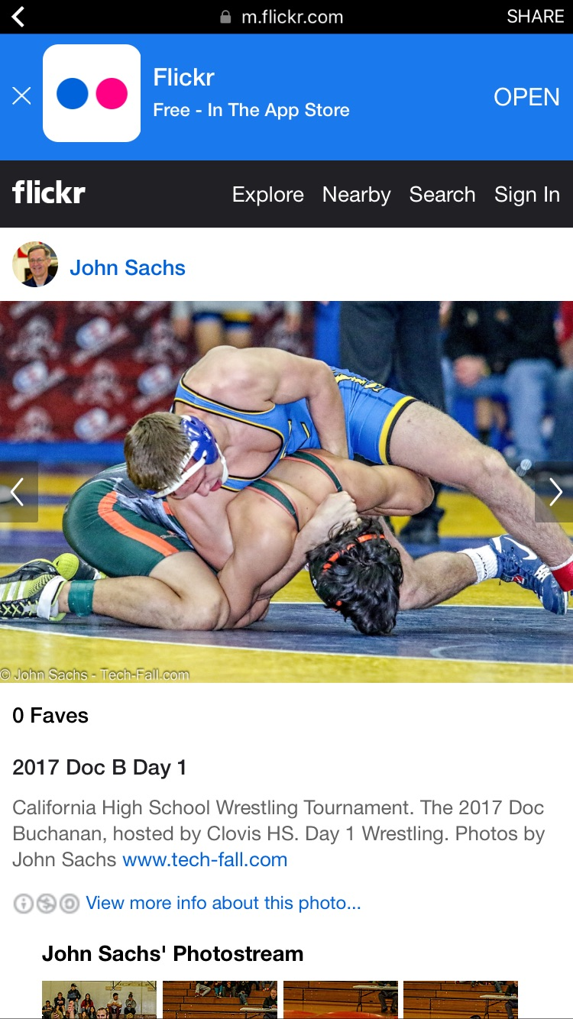
Potentially Dangerous\illegal hold

Slide 17
Videos
https://www.youtube.com/watch?v=oW8Mf3IL4zA – flying squirrel
https://www.youtube.com/watch?v=Hld3Ps4q-5k - neutral single back flip
https://www.youtube.com/watch?v=lsOulbQ1q7U –
front flip
https://www.youtube.com/watch?v=yv5ceW80aTw – Magic stick
https://www.youtube.com/watch?v=KIC7NA52uaw - cut back
https://www.youtube.com/watch?v=1IGZ5dyNfrI – cut back 2
https://www.youtube.com/watch?v=dVaCSdXDQCg – neutral slam
https://www.youtube.com/watch?v=bhj9N6_Gp3M – Gilman slam

Slide 18
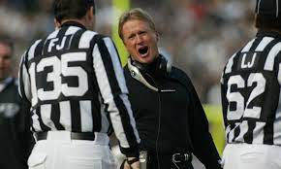
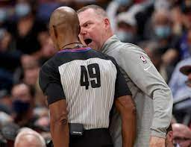
Coach Misconduct\Unsportsmanlike Conduct

Slide 19
Coach misconduct penalty sequence
Coach misconduct results in the following:
a. First offense - warning;
b. Second offense - deduct one team
point;
c. Third offense - deduct two team points and removal of the head coach for the remainder of the day. The penalty sequence starts anew each day. See Penalty Chart
No warning for approaching table to discuss score or time.

Slide 20
What are the distinctions between coach misconduct and unsportsmanlike conduct with regard to coaches and possible ejection?
RULING: Coach misconduct applies only to the specific situation of a coach questioning the misapplication of a rule or questioning the judgment of the referee at the scorer's table. Rule 6-6-6 indicates each time a penalty occurs it is accumulated by the team. It does not matter how many different individuals are involved when ejection occurs, it will be the head coach who is to be removed. The removal shall be for the remainder of the day. Coach misconduct violations are cumulative throughout the dual or tournament each day. (Note: the second day of a tournament would start the sequence over again.) (7-5-3; 7-5-4; 8-1-5)
Unsportsmanlike conduct is charged to an individual and carries through until the end of the event. If an individual were to be removed under this provision, he/she could not compete or coach for the remainder of the event.

Slide 21
Reminders
Don’t get baited to the corner or bench to discuss a call.
No warning for trip to table to discuss score or time only.
Remind wrestlers to stay in the center, keep hands at your side when speaking to coach
Keep your eye on wrestlers, face the center circle when at table
Keep explanations short and to the point
Don’t provide unsolicited explanations after the match
Removal due to coach misconduct is for the day - applies to head coach

Slide 22
Reminders
No need to show rule book or interpretation if coach requests during match
The referee shall not use TV monitoring, replay or other video equipment in making decisions related to the match.
No warning for badgering from the corner, can go direct to unsportsmanlike conduct -1 team point.

Slide 23
Question 1
In a dual meet coach from team A is badgering the official from the corner and comments are very unsportsmanlike. Is there a warning in this situation if the coach does not approach the table?
No penalize for unsportsmanlike appropriately without warning, the sequence is 1-2 and removal from premises by home management. If unsportsmanlike is behavior is flagrant penalize 3 team points without warning and alert home management.

Slide 24
Question 2
In an individual tournament the head coach from Team B calmly approaches the scorer’s table and asks for clarification on an OOB call made, it is determined there was no misapplication of the rule. After informing the coach that the call will stand the coach informs you that he would like to protest the call and would like to speak to the head official. What is the appropriate action in this scenario?
Inform the coach there is not a protest procedure in place under NFHS rules, warn the coach for coach misconduct as the call in question did not change. Since this is a tournament keep in mind that the sequence for coach misconduct is W-1-2 and removal from premises. Warnings and penalties for coach misconduct reset on each day of a multi-day tournament however all coach misconduct penalties should be reported to the head official and head table. The head coach is removed if necessary regardless of which coach was warned and all warnings and penalties are cumulative for the day.

Slide 25
Stalling
Neutral
Backing out
Watching clock
Slow getting back to the center and getting set
Blocking, underhook, two on one, hips back
Difference of 3 shots

Slide 26
Stalling
Top
Only riding with no attempt to turn
Parallel ride with no attempt to tilt
Bar or half with no attempt to turn
Staying behind man in rear standing position without an attempt to return
Riding legs with no attempt to turn
Dropping to legs to hang on

Slide 27
Stalling
Bottom
Head on man
No attempt to build up
Elbows in
Hand control without attempt to escape
Watching clock
Being overpowered is not stalling
Holding onto hands while top man has legs in

Slide 28
THANK YOU!

